Slide 1
Technical Interviewing Tips ‘n’ Tricks

Slide 2

There is no guaranteed way to get job, ace an interview, be something you’re not
Also, some of this may be opinion

Slide 3
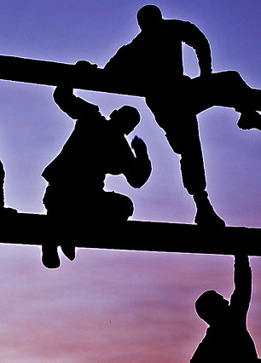
Challenges for the Interviewee
Needlessly nervous, or…
Overly confident
It’s you vs. a big ol’ stack of resumes
Unknown unknowns
Notes:
1 Needlessly nervous - I always try to make the candidate feel comfortable. I start with easy questions.
Overly confident – other end of spectrum. Confidence is good, but can come off the wrong way. Can make you appear uninterested or “too good”
Stack of resumes - Lots of people apply for jobs. Getting an interview can be tough. Standing out in an interview can be tough.
Unknowns - You never know what you are walking into. Someone could have had a bad day. Be looking for something specific.

Slide 4
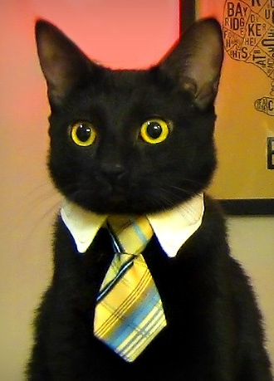
Challenges for the interviewer
Evaluating expertise in a single sitting is nearly impossible
At times, an endless schedule of interviews
Keeping a flow during the interview
Asking good questions
Notes:
Giving an interview is hard.
30-60 minutes isn’t enough. Not sure the marathon 8 hour interviews are the right answer either.
Have multiple technical interviews if possible. As a candidate, multiple interviews is usually a good sign. Companies want to get it right.
Interviewing can be “steaky”. Can have a lot of promising candidates and then not any for a while. It’s weird. And demoralizing.
Let’s be honest, we aren’t all social butterflys.
Coming up with good questions is hard. You want to give the candidate an opportunity to shine.

Slide 5

“You’re looking for people who are
Smart, and
Get things done.
That’s it. That’s all you’re looking for.”
-- Joel Spolsky (2006)
From the article The Guerrilla Guide to Interviewing (version 3.0)
Notes:
When I first started interviewing, I read the this article. Changed my point of view on what a company needs. You should read it.
Smart – aptitude, can learn new things. Remember, technology is always changing
Get things done – practical, knows when a
Hire or no hire

Slide 6

Things to expect in an interview
Open ended questions
Trivia questions
Coding
Coding on paper
Discussion on projects

Slide 7
Passion
“People who are passionate about the work they do get things done. And are usually smart.”
-- Me, just now
Notes:
Passion has to be the #1 thing I am looking for
Do you live to code? I can usually tell. Have an odd fascination for something? Excellent!
Are you coding outside of work? What?
The best interviews are ones that turn into conversations. A good interviewer will ask open ended questions that spur conversation. An excellent candidate will seize the opportunity
It’s better to say too much than too little on a subject
Trivia or Question and answer sessions are the worst. Who cares if you can name the order of events in an ASP.NET webforms page. Know who knows that and can tell you in 15 seconds? Google.
Some companies use this as their bread in butter. To me, their interviews lack passion and I can only guess their company does too.

Slide 8

Doing well with what you know
It’s okay to be new (you’ve got passion, right?)
Education is good, but real-world experience is muy beuno
Have working knowledge of current concepts
Know the companies technology stack. Interview questions likely based on it
Be confident with what you do know
Notes:
I see a lot of folks who downplay themselves. It’s unfortunate. I’m not expecting someone with less experience to be a potential Google-quality candidate.
If you have less experience I’m likely going to ask about things you did before you started working or you do after hours
If you have 10+ years of experience, I’m going to expect a little more than someone who has 2.
Going back to Spolsky’s article, it’s not enough to be smart. You have to get things done. Having a proven track record is the best indicator for future success.
Too many certs
Are there any patterns, practices that are “en-vogue”? Expect questions on them. Read up on what’s out there. Read blogs. Read Hacker News.
Are you a web developer? You should know of jQuery, bunding, minification, even if you aren’t experienced in it
Guess what interviewers ask about. Things they do everyday. If they use SQL Server, expect SQL questions.
Kinda like the SAT advice, don’t second guess yourself. As much as I like people talking things out, that’s a bullet point on a different slide.

Slide 9

Doing well with who are
Communication
Ask questions
Be appropriate
Notes:
It’s true, communicate is important. You will likely work on teams. Be able to talk to technical and non-technical folks.
And interested and good candidate asks questions. Someone who cares about who they work for is likely to be a better employee. It’s an interview of the company as much as an interview of the candidate. Seize your opportunity.
Be appropriate
Dress appropriately - duh
Speak appropriately – watch your words. This isn’t your friends house. Be a professional, in short. You’d be surprised.
Don't be too casual – again, be professional

Slide 10
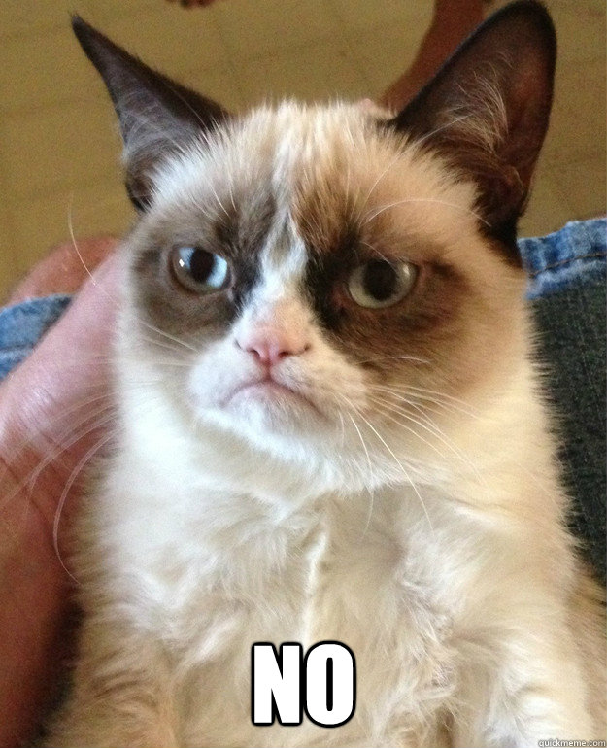
Things to avoid
You will be Googled
Avoid Buzzword Bingo
Always tell the truth
The Conflict Question™
If you don’t know an answer…
Notes:
You will likely be looked up before the interview.
Have a web presence. Post good stuff. Take down the bad stuff
If you have a “lively” facebook, please learn how to use the privacy settings
You Twitter rants will be considered
On your resume, in the interview, we are not impressed if you are simply naming technologies. I want to know what you know about them
If you lie on the interview and it gets spotted, you won’t get hired.
If it sounds fishy, even if true, don’t bring it up
“Sorta the truth” or “mostly the truth” is still a lie
Do you handle conflict. Don’t indicate yourself.
It is better to say “I don’t know” or “I’m not sure” instead of making it up and trying to pass it off as you know. If the interviewer is asking about it, they probably know the answer. There is no partial credit
Taking yourself through a problem, i.e. thinking outloud, is great.

Slide 11

Silver lining
Take an interview, even if you don’t feel qualified
Just part of the process
“No hire” is not the end of the world
Notes:
Interviewing a skill that can be learned. Some are just good at it. If offered an interview, take it. At worst, you will learn something. At best, you get a job.
If “but I’m bad it interviewing…” is your mantra, you need to interview more. Not interviewing is not going to make getting a job easier
technical interviews just part of the process. If you bonk, there are possibly other interviews
using a screen of some sort by a recruiter
Interview with management
“No hire” is not the end. If you like the company, apply again.
Figure out what the gap is. What you didn’t know. Study up. Apply again. If you come back a year latter and ace an interview you struggled on, that’s a really good sign.

Slide 12

Go get hired!
Notes:
Questions? Anything you would like to know that I haven’t answer? Any other secrets that aren’t so secret that I can divulge?

